Slide 1
Preliminary verification of trend calculations

Slide 2
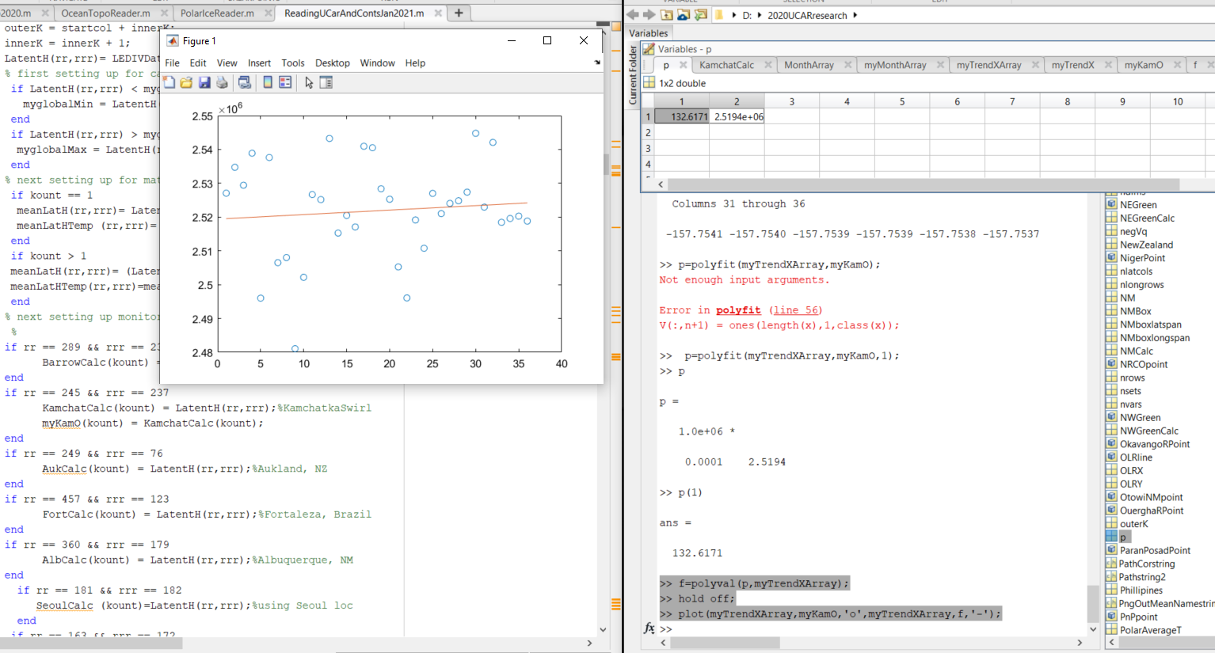
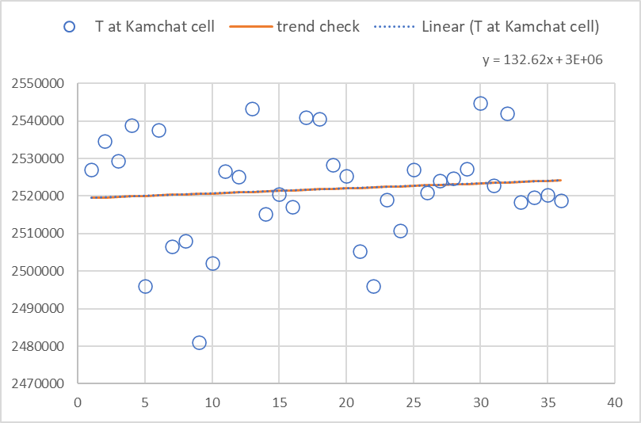
>> p=polyfit(myTrendXArray,myKamO,1);
p =
132.617117117110 2519403.01388889
>> f=polyval(p,myTrendXArray);
>> hold off;
>> plot(myTrendXArray,myKamO,'o',myTrendXArray,f,'-');
example
>> x = 1:50;
y = -0.3*x + 2*randn(1,50);
p = polyfit(x,y,1);
>> f = polyval(p,x);
plot(x,y,'o',x,f,'-')
legend('data','linear fit')
>> slope = p(1)
slope =
-0.3313
Success trying with Kamchatka swirl cell for September T
And confirmed with excel (below left from tab Kamchat Cell, of file Kamchatka Strip Check.xlsx) also

